Slide 1



EMAIL INVOICE DOWNLOADER BOT
Your Register No : 220701178
Name: Nalin Karthik K
Guide Name:
Designation and Department : 3rd Year B.E.CSE

Slide 2


Abstract:
This project uses Robotic Process Automation (RPA) with UiPath to streamline the process of downloading invoice attachments from emails and storing them locally. The solution is designed to automatically monitor incoming emails, search for a specified keyword (such as “Invoice”) in the subject or body, and retrieve attachments from relevant messages. When a matching email is found, the attachment is saved to a specified local directory, allowing for quick and organized access to invoices.
2

Slide 3


Need for the Proposed System
The primary objective of this project is to develop an efficient and automated solution for downloading and organizing invoice attachments from email using Robotic Process Automation (RPA) with UiPath. By implementing this automation, the project aims to reduce manual workload, improve accuracy, and streamline the invoice management process for organizations, particularly for finance and accounting departments.
3

Slide 4
Main Objective
The main objective of this project is to develop a Robotic Process Automation (RPA) system that automates the retrieval, processing, and organization of invoice attachments from emails. By connecting to an email server, the RPA system will identify relevant invoices based on specific keywords, download the attachments, and store them in a designated local directory for easy access and retrieval. This automation aims to minimize human intervention, enhance processing efficiency, reduce manual errors, and streamline document management workflows, ultimately improving productivity and consistency in handling invoices.
4

Slide 5
Architecture
User Interface: Allows users to start the RPA process and view status updates, errors, and completion reports.
UiPath RPA Bot: The main automation bot connects to the email server, retrieves emails, filters for relevant invoices, downloads attachments, and stores them locally.
Email Server (IMAP/Outlook): Provides email access for the RPA bot, enabling it to fetch new messages for processing.
Email Filtering: Checks email subject and body for invoice-related keywords to identify relevant messages.
Attachment Processing: Downloads and verifies invoice attachments, ensuring they meet predefined format requirements (e.g., PDF, Excel).
Storage Management: Saves attachments in a structured local directory, organized by date, client name, or invoice number for easy retrieval.
Logging and Reporting: Logs activity, errors, and generates summary reports after each process run.
Database/Storage System: Optionally, stores attachment metadata for easy search and long-term access.
Error Handling and Notification: Manages errors with notifications and logs for troubleshooting.
End Process: RPA bot completes the cycle and awaits the next trigger, either scheduled or user-initiated.
5

Slide 6
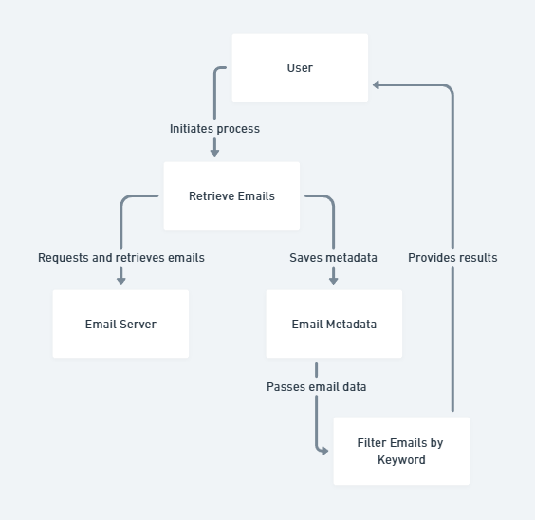
Functional Description
Description: This module connects to the configured email server (e.g., IMAP or Outlook) to retrieve new emails from the inbox. It filters emails based on specified keywords, such as "Invoice" in the subject or body, identifying only relevant emails that contain potential invoice attachments. This step ensures that only necessary emails are processed, reducing workload and optimizing the automation workflow.
6

Slide 7

Process Design
Main Process: Email Invoice Processing
The main process automates retrieving, filtering, downloading, and storing invoice attachments from emails. It begins with a trigger, connects to the email server, filters relevant emails, downloads and verifies attachments, stores them, logs actions, and generates a completion report.
Sub Processes
Email Connection: Connects to the email server and retrieves new emails.
Filtering: Identifies emails with keywords like "Invoice" for processing.
Attachment Verification: Ensures attachments are in valid formats (e.g., PDF).
Download and Storage: Downloads verified attachments to a local directory.
Error Handling and Logging: Logs errors for troubleshooting.
Reporting: Generates a summary report of actions and errors

Slide 8
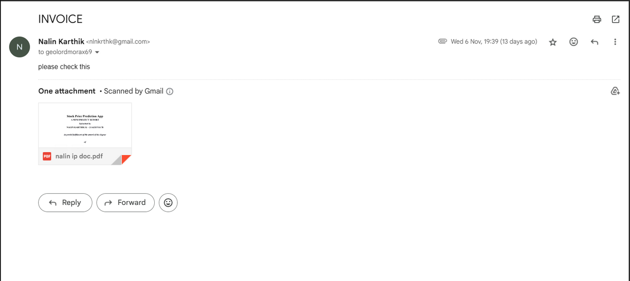
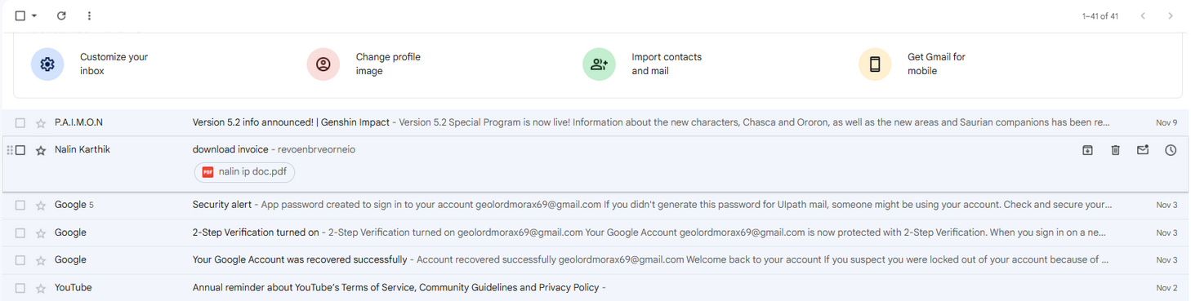
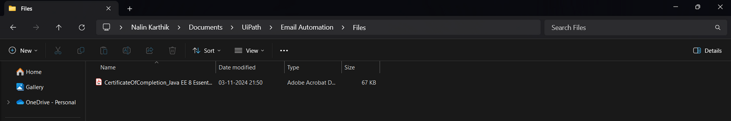
Implementation
8

Slide 9
Future Enhancements
Automated Data Extraction: Use OCR and NLP to capture key invoice details automatically.
Invoice Categorization: Implement machine learning to organize invoices by type or vendor.
Payment Integration: Connect to financial software for automated invoice payments.
Enhanced Security: Add encryption and multi-factor authentication for data protection.
Multi-Platform Compatibility: Support various email and file storage platforms.
Analytics Dashboard: Provide real-time insights on processing metrics for better management.
Intelligent Error Handling: Use AI to suggest resolutions based on past error data.
These upgrades would enhance automation, security, and efficiency, making the system more robust and scalable.
9

Slide 10
Conclusions
This RPA project successfully automates the retrieval, filtering, downloading, and storing of invoice attachments from emails, significantly reducing manual intervention and streamlining invoice processing. By implementing efficient error handling, logging, and reporting mechanisms, the system enhances reliability and ensures seamless operation. The modular design enables easy maintenance and scalability, while thorough testing guarantees functionality and robustness under different conditions. Ultimately, this solution improves productivity, accuracy, and time savings, providing an effective and automated approach to managing invoice processing tasks.
10

